Slide 1
GridSharing Simulator
David Cabinian and Bryce Rich

Slide 2
Assignment
Goal: Teach the GridSharing framework and how different parameters affect performance
Objective: Create a terminal application that computes shares allocated to servers in a GridSharing System
Part 1: Use Ito, Saito, and Nishizeki’s Share Assignment Scheme to determine which servers get which shares.
Part 2: Implement GridSharing Framework as a simulator

Slide 3
Part 2: Implement GridSharing Simulator
User Input Parameters: Leaking, Byzantine, Crashed servers, Number of rows
Display Stats: [Number of Servers, Number of Shares] for a given number of rows
Display Shares: Display the share allocation in a table
Plots: [Change in Min Servers, Server Blowup, Shares] as a function of rows
Export Shares: Save GridSharing share allocation table to .CSV file
Extra Credit:
1. Generate shares using GridSharing and secret string
2. Attempt to retrieve it using set of servers

Slide 4
Solution
Part 1: Use Ito, Saito, and Nishizeki’s Share Assignment Scheme to determine which servers get which shares
- Using Python
- Table printing library: PrettyTable
Part 2: Implement GridSharing Simulator
- Using Python
- Plotting library: Pyplot
- CSV library: CSV

Slide 5
Demo

Slide 6
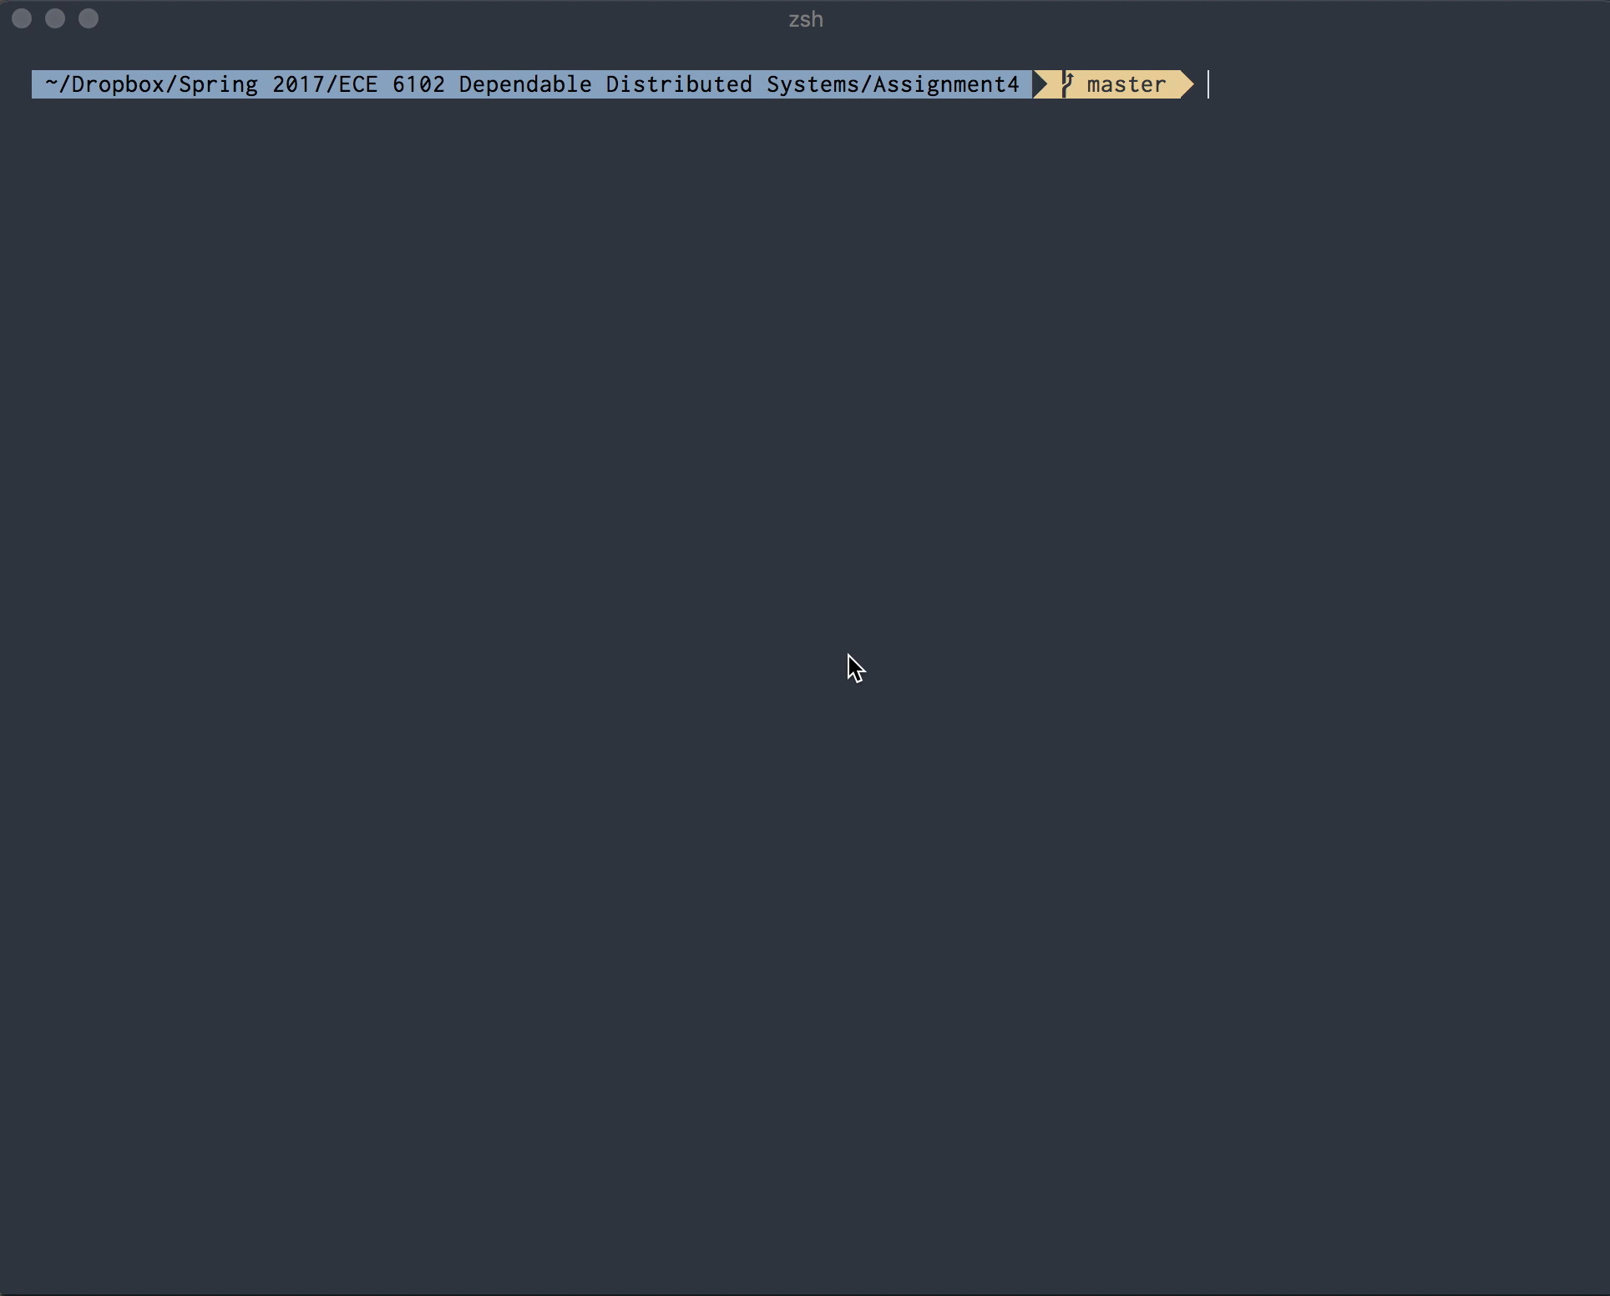

Slide 7
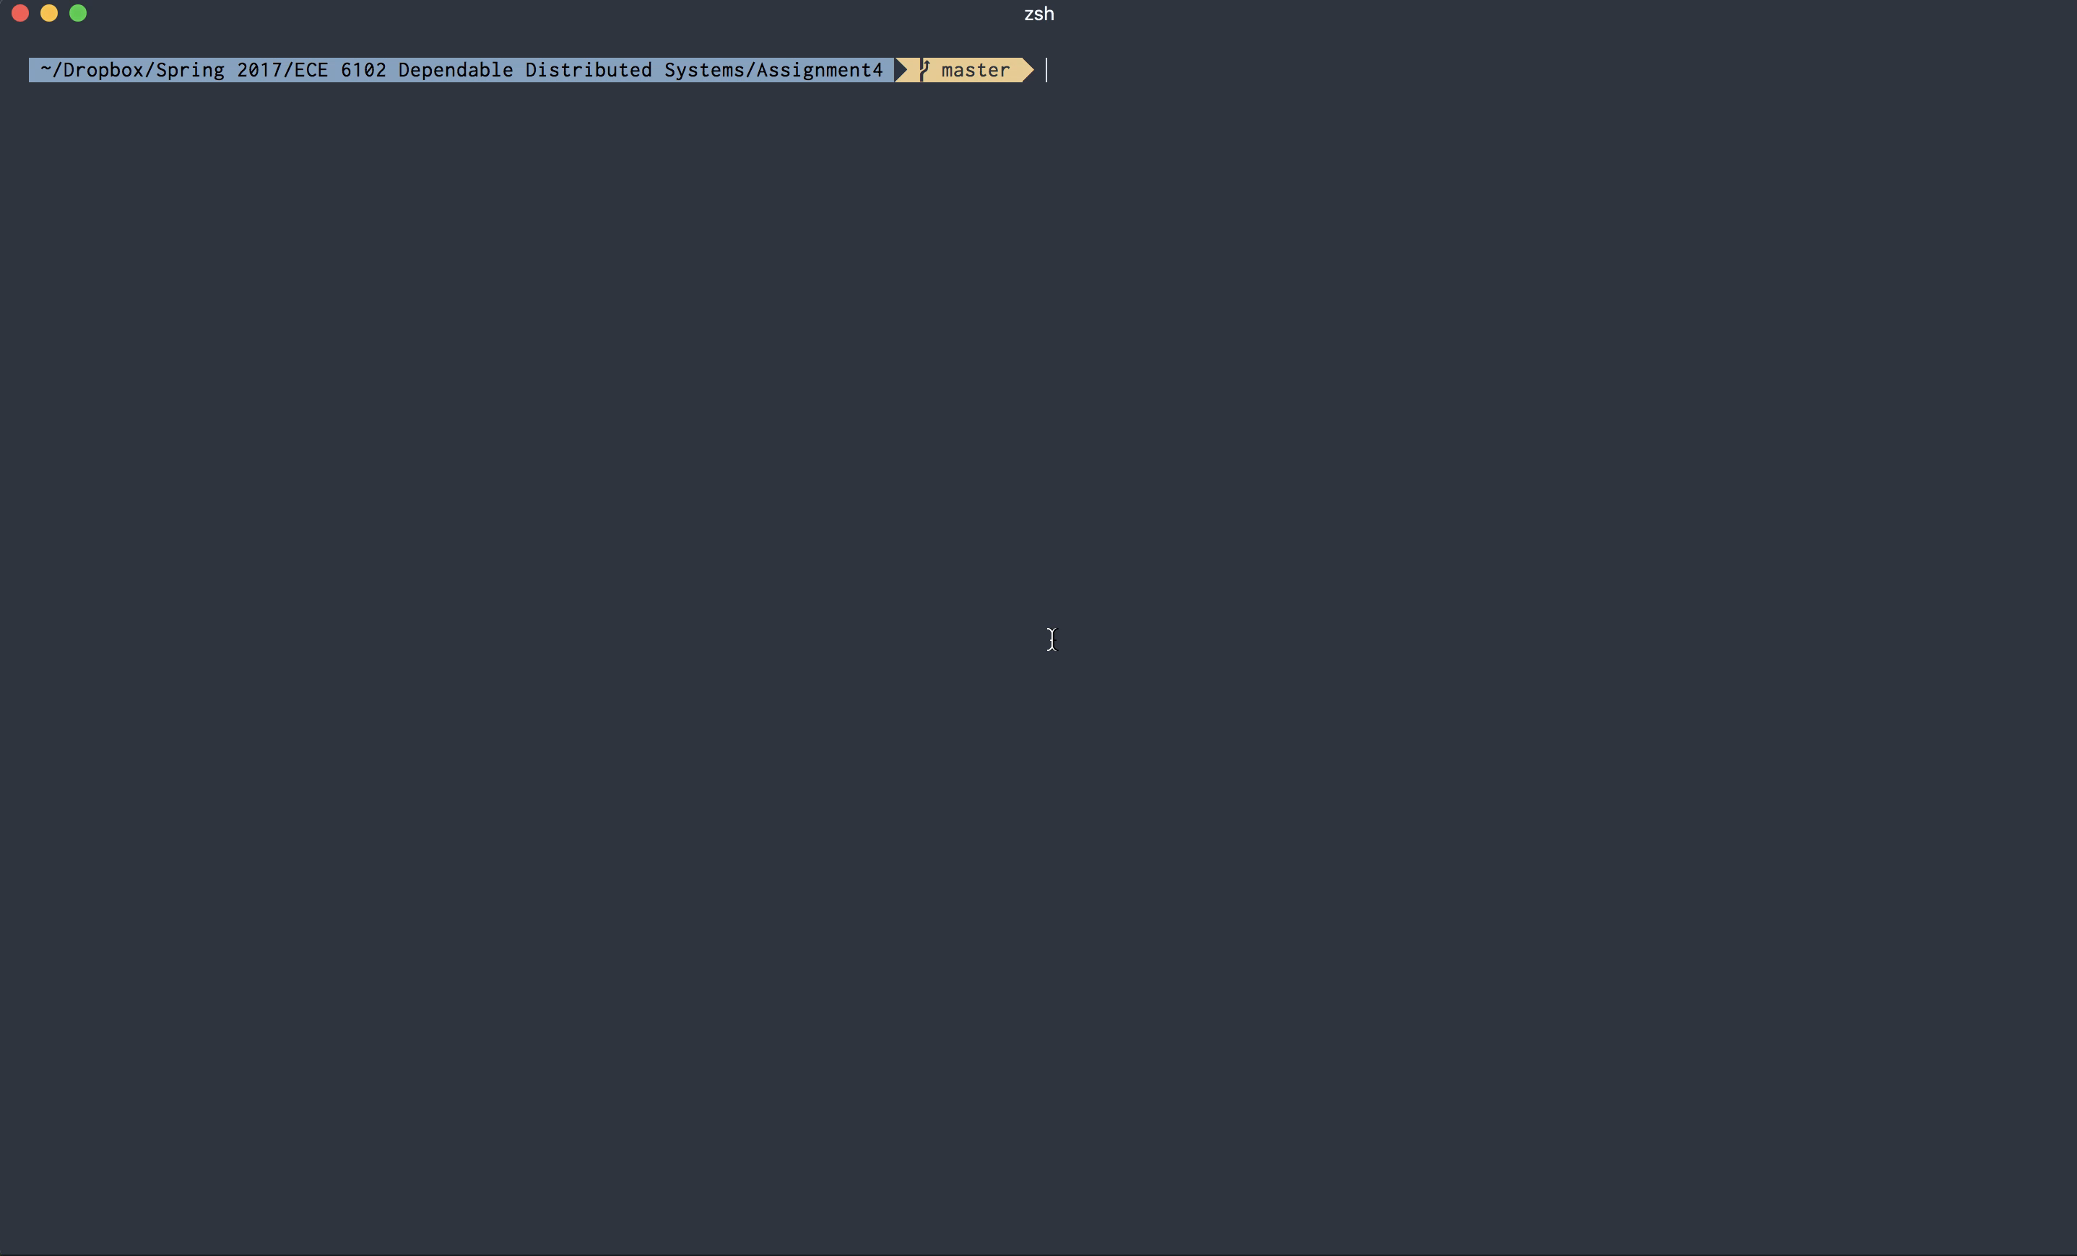

Slide 8
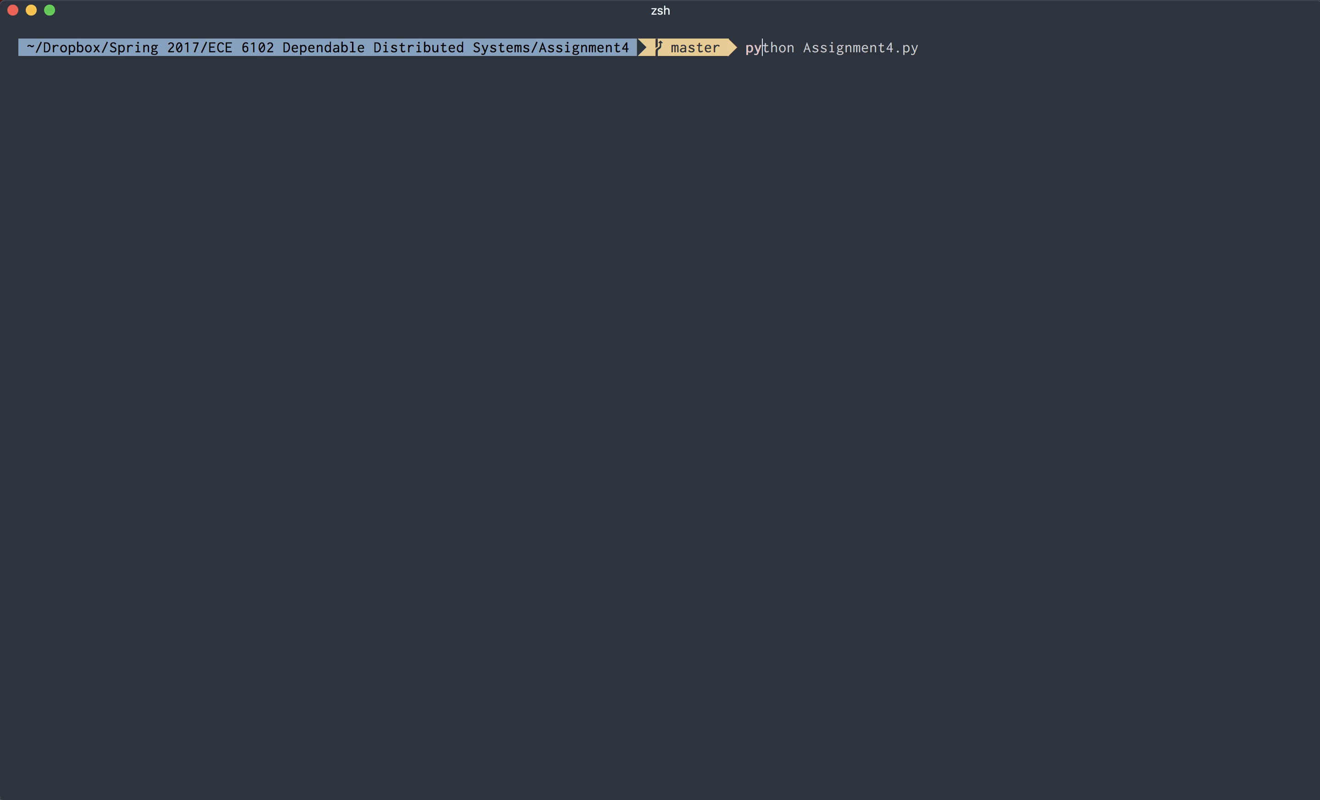

Slide 9
Extra Demos

Slide 10
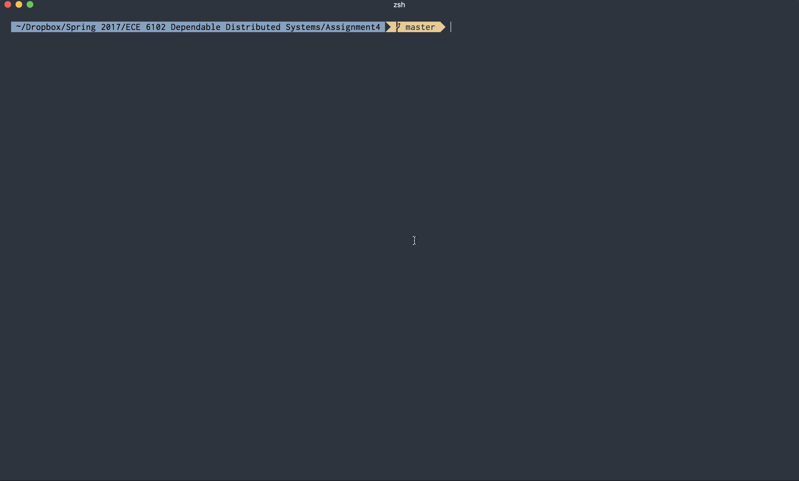

Slide 11
